Slide 1

Let There Be Light
Trainer xhevat.ibraimi@gmail.com
Assistant dejan.obradovikj@seavus.com

Slide 2
Module Contents
ASP.NET MVC
Various Project Templates
WebForms vs MVC
Creating the first Web Application
MVC Template Project Structure
ASP.NET MVC vs ASP.NET Core template
Code academy @ Skopje, 2018-2019

Slide 3
Various Project Templates
ASP.NET MVC
Aspnet Full Framework
Empty
WebForms
MVC
Web API ...and many more
Aspnet Core
Empty
WebApi
Web App (MVC/RazorPages) ...and many more
Code academy @ Skopje, 2018-2019

Slide 4
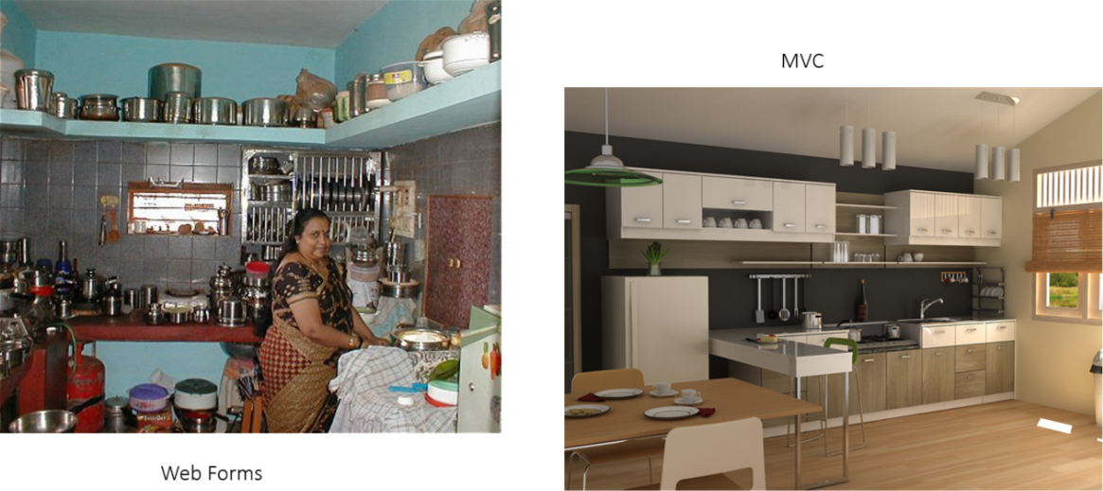
WebForms vs MVC
ASP.NET MVC
Code academy @ Skopje, 2018-2019

Slide 5
How To Create First Web App?
ASP.NET MVC
DEMO
Code academy @ Skopje, 2018-2019

Slide 6
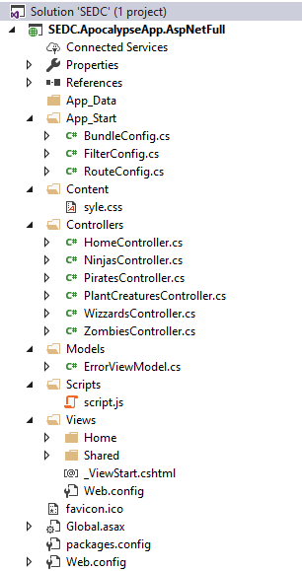
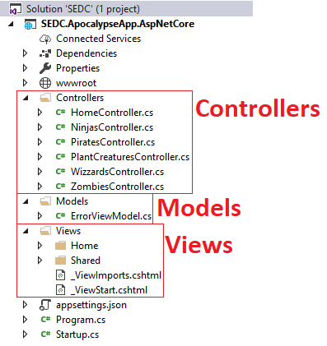
MVC Template Project Structure
ASP.NET MVC
Code academy @ Skopje, 2018-2019

Slide 7
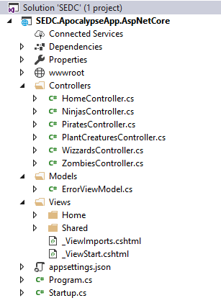
ASP.NET MVC vs ASP.NET Core template
ASP.NET MVC
Code academy @ Skopje, 2018-2019

Slide 8
?
ASP.NET MVC
Code academy @ Skopje, 2018-2019

